Slide 1

Week 2

Slide 2
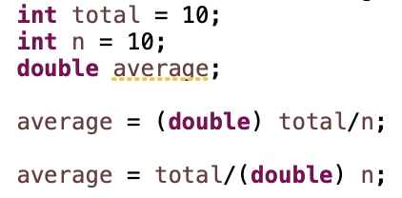
Type Casting
One type can be cast to another compatible type if appropriate
Variable total can be cast to double to ensure that real division is used, alternatively, we can cast variable n to double.

Slide 3
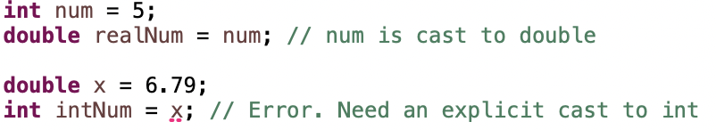
Type Casting
Java can automatically cast an int to a double
Assigning a double to an int without a cast will cause a compile-time error

Slide 4
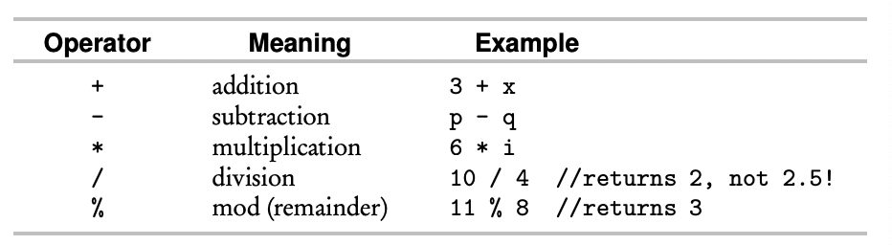
Arithmetic Operators
These operators can be applied to types int and double
If an operation involves both a double and an int, the int is promoted to double, and the result is double

Slide 5
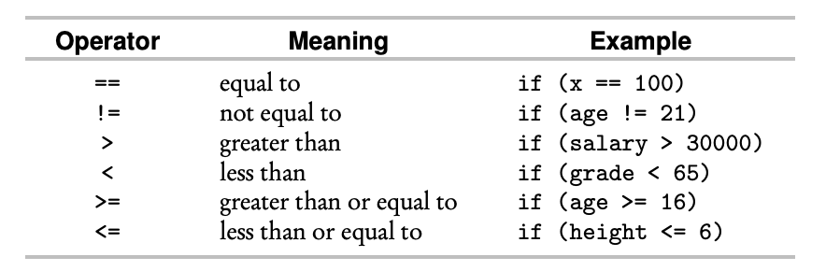
Relational Operators
Relational operators are used in boolean expressions that evaluate to true or false

